Slide 1

8th Grade Math: Pre-Algebra
Unit 1, Lesson 3 Applying the Laws of Exponents – Part 2 Volume 1, pg. 16

Slide 2


Benchmark
MA.7.NSO.1.1
Know and apply the Laws of Exponents to evaluate numerical expressions and generate equivalent numerical expressions, limited to whole-number exponents and rational number bases.
volume 1, pg. 16

Slide 3
Integrated Mathematical Thinking and Reasoning Standards
MA.K12.MTR.3.1 Complete tasks with mathematical fluency.
MA.K12.MTR.4.1 Engage in discussions that reflect on the mathematical thinking of self and others.
MA.K12.MTR.5.1 Use patterns and structure to help understand and connect mathematical concepts.
volume 1, pg. 16

Slide 4

Learning Targets
I can use the quotient of powers, power of a quotient, and zero exponent laws to simplify expressions.
I can rewrite expressions using the laws of exponents to generate equivalent expressions.
volume 1, pg. 16

Slide 5

Warm-Up
volume 1, pg. 16

Slide 6
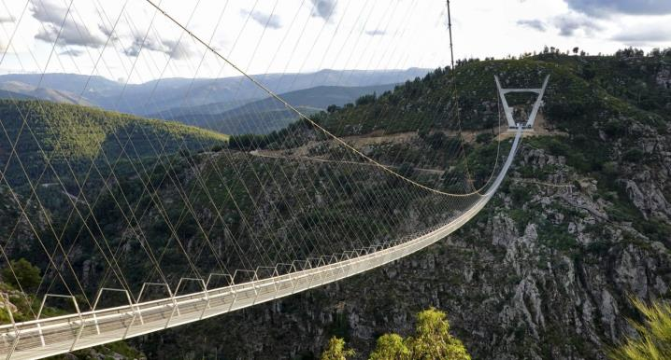
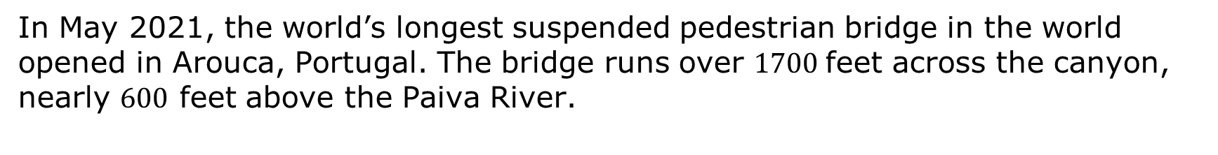
1.3.1 Warm-Up: Notice and Wonder
In May 2021, the world’s longest suspended pedestrian bridge in the world opened in Arouca, Portugal. The bridge runs over $1700$feet across the canyon, nearly $600$ feet above the Paiva River.
What do you notice?
What do you wonder?
volume 1, pg. 16

Slide 7

Exploration
volume 1, pg. 17

Slide 8

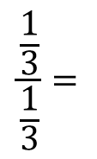
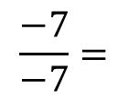

1.3.2 Exploration: Exponent Laws
Evaluate each of the following expressions.
$$\frac{\frac{1}{3}}{\frac{1}{3}}=$$
$$\frac{10}{10}=$$
$$\frac{−7}{−7}=$$
If the numerator and denominator have the same value, the quotient is _____.
volume 1, pg. 17

Slide 9
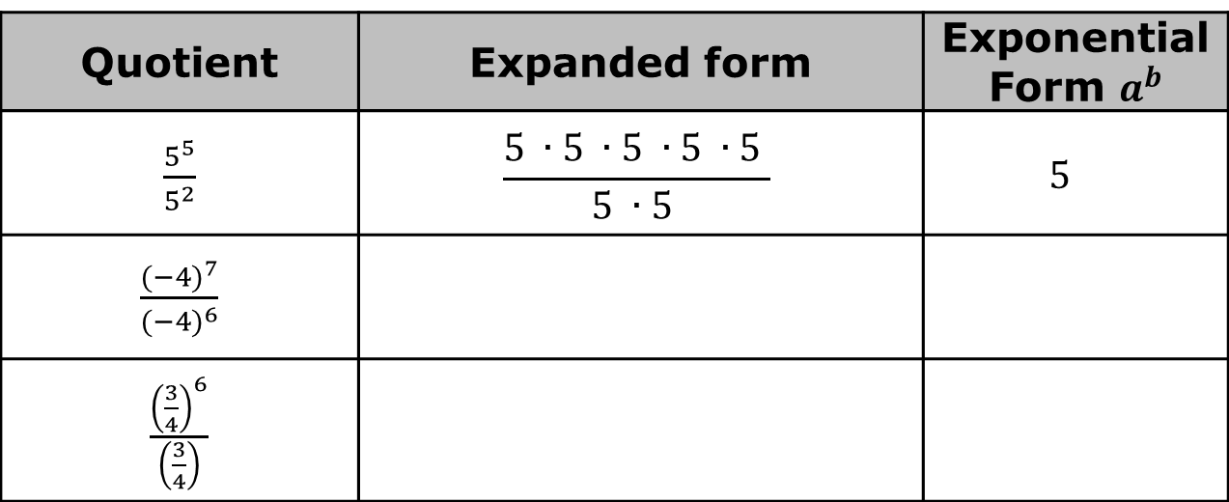
The Quotient of Powers Exponent Law can be used to rewrite expressions when dividing two powers that have the same nonzero base.
Complete the table.
Quotient | Expanded form | Exponential Form $a^{b}$
$\frac{5^{5}}{5^{2}}$ | $$\frac{5 ∙5 ∙5 ∙5 ∙5 }{5 ∙5 }$$ | $$5^{ }$$
$\frac{{(−4)}^{7}}{{(−4)}^{6}}$
$\frac{{\left(\frac{3}{4}\right)}^{6}}{\left(\frac{3}{4}\right)}$
volume 1, pg. 17

Slide 10
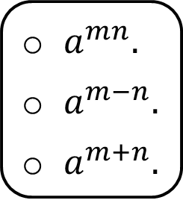
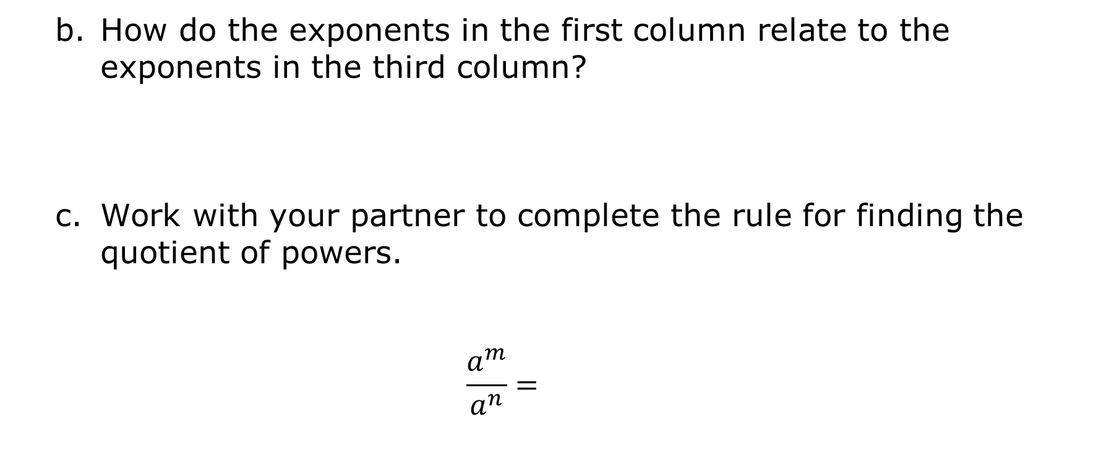
How do the exponents in the first column relate to the exponents in the third column?
Work with your partner to complete the rule for finding the quotient of powers.
$$\frac{a^{m}}{a^{n}}=$$
$a^{mn}.$
$a^{m−n}.$
$a^{m+n}.$
volume 1, pg. 17

Slide 11
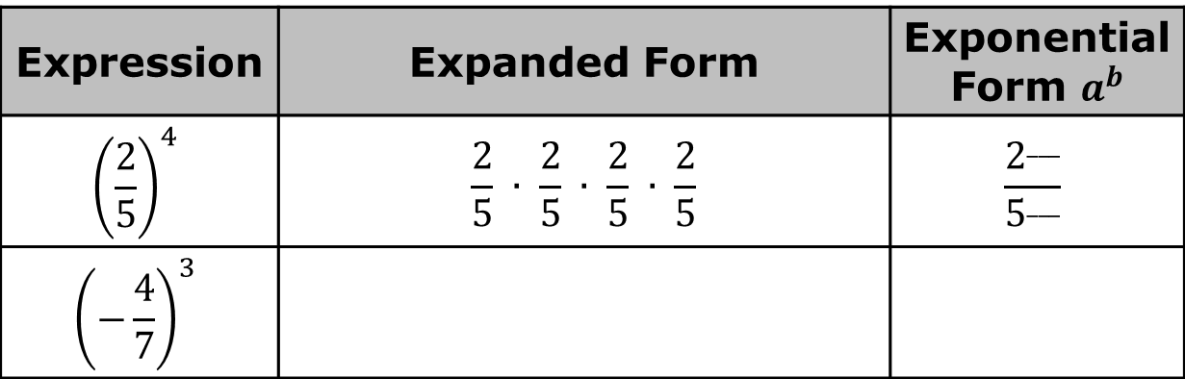
The Power of a Quotient Exponent Law can be used to rewrite expressions when a fraction is raised to an exponent.
Complete the table.
How do the exponents in the first column relate to the exponents in the third column?
Expression | Expanded Form | Exponential Form $a^{b}$
$${\left(\frac{2}{5}\right)}^{4}$$ | $$\frac{2}{5} ∙ \frac{2}{5} ∙ \frac{2}{5} ∙ \frac{2}{5}$$ | $$\frac{2^{___}}{5^{___}}$$
$${\left(−\frac{4}{7}\right)}^{3}$$
volume 1, pg. 17

Slide 12
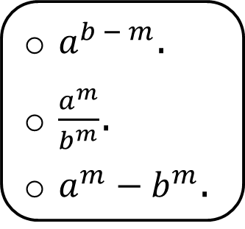
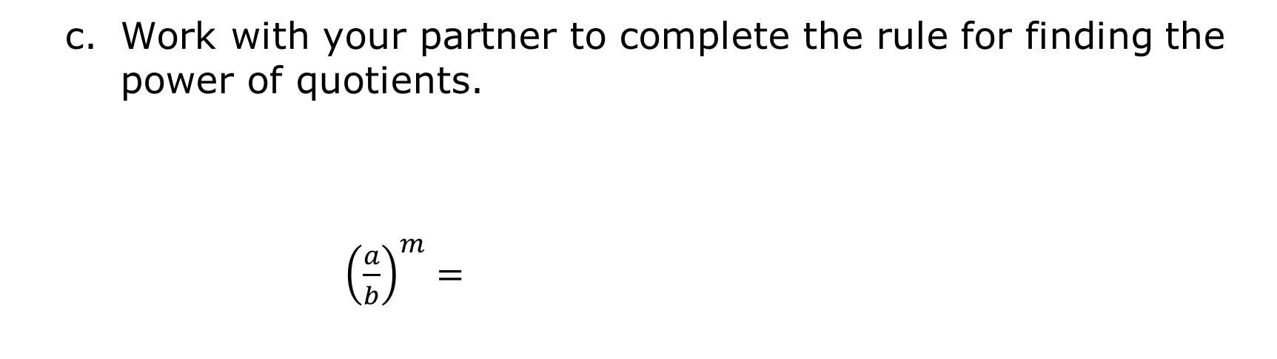
Work with your partner to complete the rule for finding the power of quotients.
${\left(\frac{a}{b}\right)}^{m}=$
$a^{b − m}$.
$\frac{a^{m}}{b^{m}}$.
$a^{m}{ − b}^{m}$.
volume 1, pg. 18

Slide 13
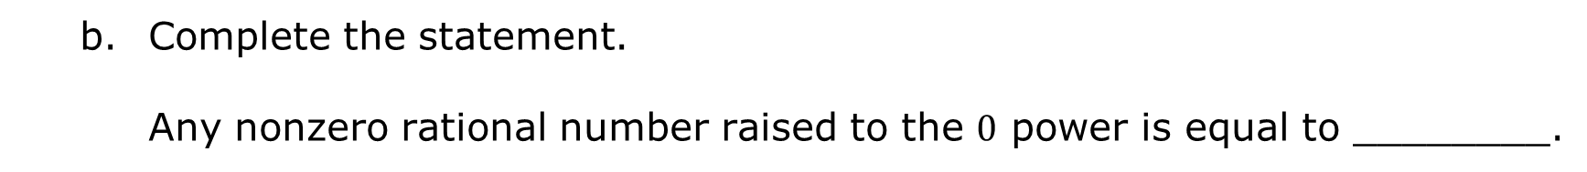
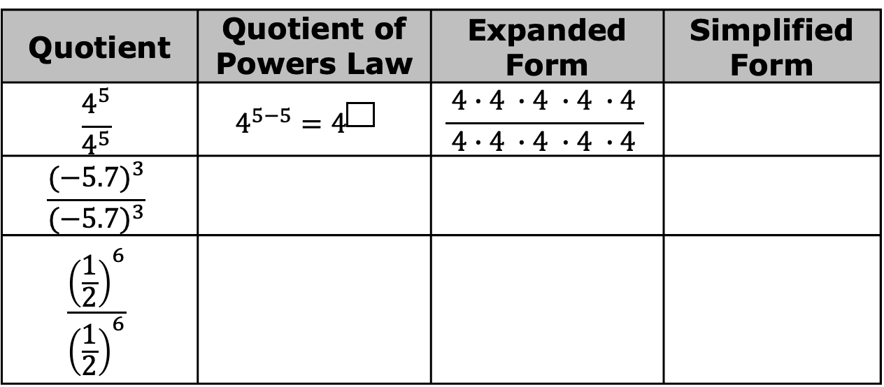
The Zero Exponent Law is used to rewrite expressions when a nonzero rational number is raised to the zero power.
Complete the table.
Quotient | Quotient of Powers Law | Expanded Form | Simplified Form
$$\frac{4^{5}}{4^{5}}$$ | $$4^{5−5}=4^{\boxed{} }$$ | $$\frac{ 4∙4 ∙4 ∙4 ∙4 }{4∙4 ∙4 ∙4 ∙4}$$
$$\frac{{(−5.7)}^{3}}{{(−5.7)}^{3}}$$
$$\frac{{\left(\frac{1}{2}\right)}^{6}}{{\left(\frac{1}{2}\right)}^{6}}$$
Complete the statement.
Any nonzero rational number raised to the $0$ power is equal to ________.
volume 1, pg. 18

Slide 14

Bring It Together
volume 1, pg. 18

Slide 15


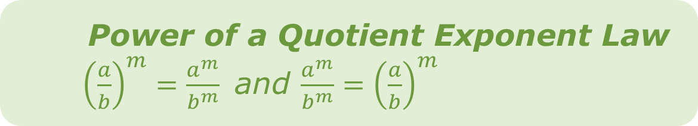
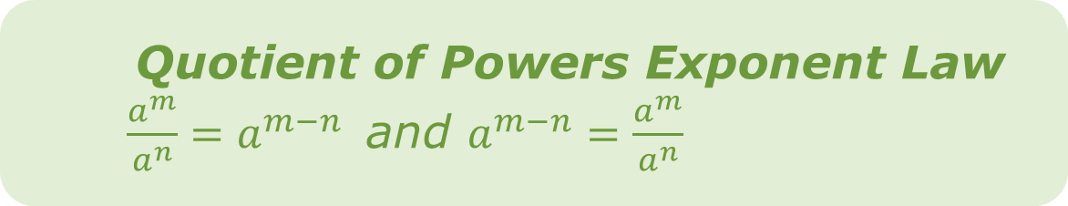
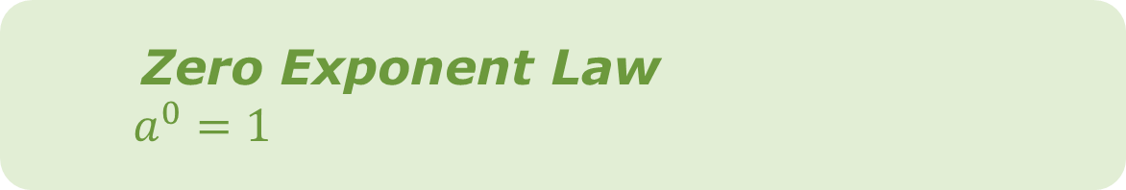
1.3.3 Bring It Together: Exponent Laws
Quotient of Powers Exponent Law
$\frac{a^{m}}{a^{n}}=a^{m−n}$ and $a^{m−n}=\frac{a^{m}}{a^{n}}$
Power of a Quotient Exponent Law
${\left(\frac{a}{b}\right)}^{m}=\frac{a^{m}}{b^{m}}$ and $\frac{a^{m}}{b^{m}}={\left(\frac{a}{b}\right)}^{m}$
Zero Exponent Law
$a^{0}=1$
volume 1, pg. 18

Slide 16

Your Turn
volume 1, pg. 19

Slide 17
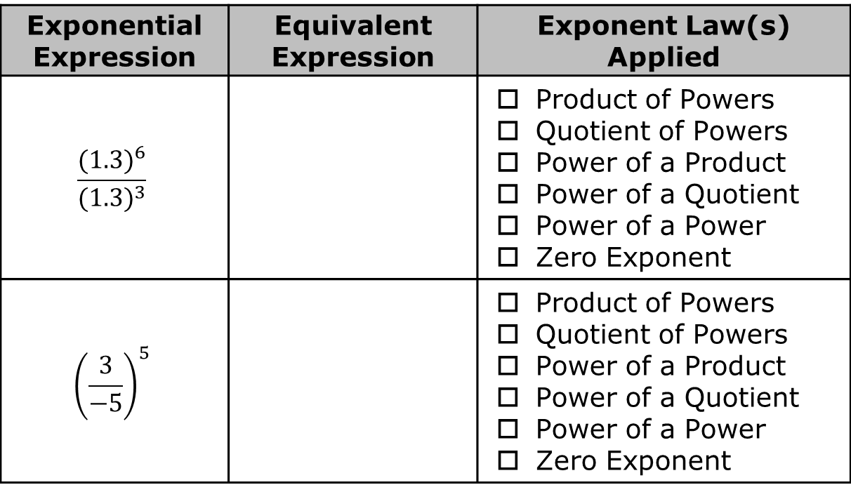
1.3.4 Your Turn!
Complete the table by rewriting each expression as an equivalent expression using the laws of exponents.
Exponential Expression | Equivalent Expression | Exponent Law(s) Applied
$$\frac{{(1.3)}^{6}}{{(1.3)}^{3}}$$ |  | Product of Powers Quotient of Powers Power of a Product Power of a Quotient Power of a Power Zero Exponent
$${\left(\frac{3}{−5}\right)}^{5}$$ |  | Product of Powers Quotient of Powers Power of a Product Power of a Quotient Power of a Power Zero Exponent
volume 1, pg. 19

Slide 18

Exponential Expression | Equivalent Expression | Exponent Law(s) Applied
$${\left(−3\right)}^{2}∙(−3)$$ |  | Product of Powers Quotient of Powers Power of a Product Power of a Quotient Power of a Power Zero Exponent
$${(−4)}^{0}$$ |  | Product of Powers Quotient of Powers Power of a Product Power of a Quotient Power of a Power Zero Exponent
volume 1, pg. 19

Slide 19
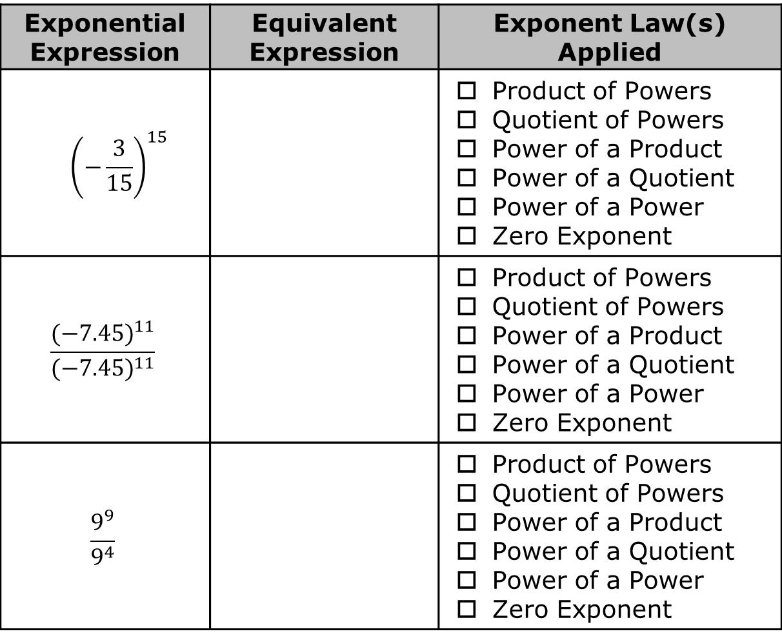
Exponential Expression | Equivalent Expression | Exponent Law(s) Applied
$${ \left(−\frac{3}{15}\right)}^{15}$$ |  | Product of Powers Quotient of Powers Power of a Product Power of a Quotient Power of a Power Zero Exponent
$$\frac{{(−7.45)}^{11}}{{(−7.45)}^{11}}$$ |  | Product of Powers Quotient of Powers Power of a Product Power of a Quotient Power of a Power Zero Exponent
$$\frac{9^{9}}{9^{4}}$$ |  | Product of Powers Quotient of Powers Power of a Product Power of a Quotient Power of a Power Zero Exponent
volume 1, pg. 19

Slide 20

Collaboration
volume 1, pg. 20

Slide 21

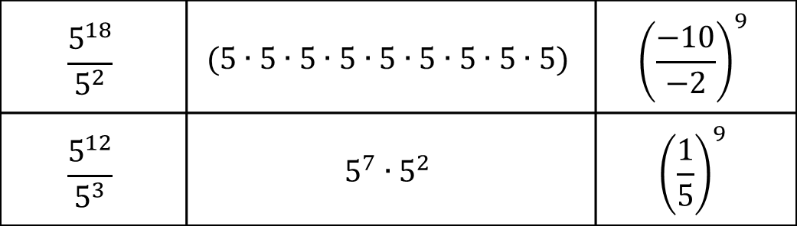
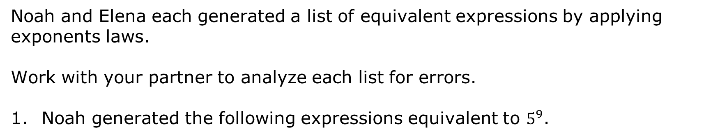
1.3.5 Collaboration: Analyzing Equivalent Expressions
Noah and Elena each generated a list of equivalent expressions by applying exponents laws.
Work with your partner to analyze each list for errors.
Noah generated the following expressions equivalent to $5^{9}$.
$$\frac{5^{18}}{5^{2}}$$ | $$(5∙5∙5∙5∙5∙5∙5∙5∙5)$$ | $${\left(\frac{−10}{−2}\right)}^{9}$$
$$\frac{5^{12}}{5^{3}}$$ | $$5^{7}∙5^{2}$$ | $${\left(\frac{1}{5}\right)}^{9}$$
Circle the equivalent expressions and draw an X through the expressions that are not equivalent to the original expression.
volume 1, pg. 20

Slide 22
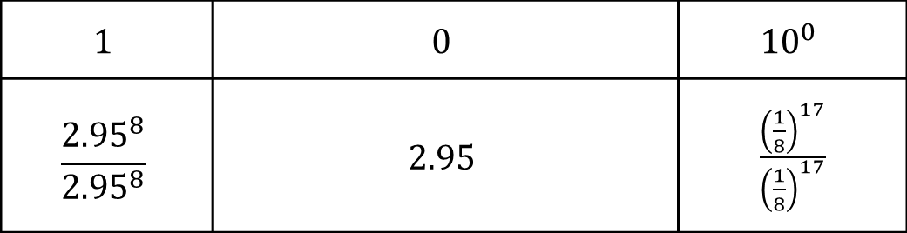
Elena generated the following expressions as equivalent to ${(2.95)}^{0}$.
$$1$$ | $$0$$ | $${10}^{0}$$
$$\frac{{2.95}^{8}}{{2.95}^{8}}$$ | $$2.95$$ | $\frac{{\left(\frac{1}{8}\right)}^{17}}{{\left(\frac{1}{8}\right)}^{17}}$
Circle the equivalent expressions and draw an X through the expressions that are not equivalent to the original expression.
volume 1, pg. 20

Slide 23

Wrap-Up
volume 1, pg. 20

Slide 24






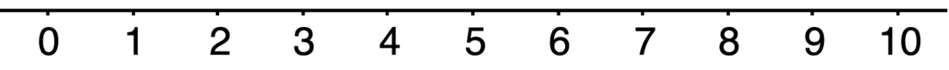
1.3.6 Wrap-Up: Reflection
Circle the value on the scale that matches your understanding of each learning target.
I can use the quotient of powers, power of a quotient, and zero exponent laws to simplify expressions.
volume 1, pg. 20

Slide 25
I can rewrite expressions using the laws of exponents to generate equivalent expressions.
volume 1, pg. 20

